Slide 1
HAND GESTURE RECOGNITION USING DEPTH CAMERA
Presented By:
Ankita Nasipuri LIT2015012
Puja Kumari LIT2015017
Samriddhi Niranjan LIT2015021
Kajol LIT2015022
Project Mentor: Prof. Anupam Agrawal

Slide 2
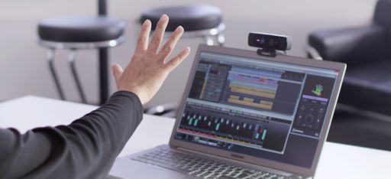
INTRODUCTION
Gestures are an interaction technique that can deliver more natural, creative and intuitive methods for communicating with computers
Gesture recognition aims to create a system which can identify human gestures and use them to convey information to device control
The ultimate aim is to bring Human Computer Interaction to a regime where interactions with computers will be as natural as an interaction between humans

Slide 3
MOTIVATION
Before the introduction of depth cameras, webcams were used as an image acquisition device for hand gesture recognition.
The drawbacks faced were reduction in accuracy in case of cluttered background and sensitivity to lighting variations.
Kinect sensor provides the depth information of an image which is useful for removing unnecessary background information.
So we intend to use both the RGB and depth information provided by Kinect to achieve higher accuracy even in cluttered background.

Slide 4
LITERATURE SURVEY

Slide 5
S.No. | Paper Name and Year | Methodology Used | Merits | Demerits
1 | Sign Language Fingerspelling Classification from Depth and Color Images using a Deep Belief N/W (Department of Computer Science Laval University Quebec City, QC, 2015) | A feature extraction technique using a deep belief network used for hand pose recognition using depth and intensity images captured from a Microsoft Kinect sensor. Gestures Recognized:American Sign Language | The results were obtained with precision and recall measures, computed for each letter. | The system is only capable of classifying static gestures.
2 | A Real-time Dynamic Hand Gesture Recognition System Using Kinect Sensor (International Conference on ROBIO,2015) | Motion orientation is extracted as the unique feature and Support Vector Machine (SVM) is used as the recognition algorithm. Gestures Recognized:Arabic Numbers and A-Z | An innovative gesture spotting method which determines the start and end point of the motion trajectory. | Low recognition rate of some characters.
3. | Online Handwriting Recognition using Depth Sensors (13th International Conference on Document Analysis and Recognition (ICDAR), IEEE, 2015) | Fingertip segmentation using K-means algorithm. Character formation is done by connecting fingertip positions to form a trajectory. | An efficient implementation that uses less time for pre-processing. 100% accuracy is achieved for limited vocabulary. | Characters which are written very fast are distorted due to errors in fingertip positions.

Slide 6
OBJECTIVE
Make a software system which takes visual input from Microsoft Kinect depth camera and recognises dynamic hand gestures for controlling media player application.
Appropriate commands are executed on VLC media player corresponding to different hand gestures.

Slide 7

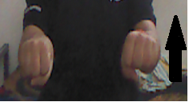
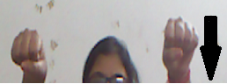
GESTURE | CORRESPONDING COMMAND
CLAPPING | PLAY/PAUSE
BOTH HANDS UP | INCREASE VOLUME
BOTH HANDS DOWN | DECREASE VOLUME

Slide 8


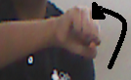
PALM | QUIT
CLOCKWISE ROTATION | PLAY NEXT VIDEO
ANTI-CLOCKWISE ROTATION | PLAY PREVIOUS VIDEO

Slide 9
SCOPE
The software system will take visual input from Microsoft Kinect depth camera.
The software system should work for dynamic hand gestures.
Gestures involve the use of one or both hands.
Background environment will be dynamic.

Slide 10
Gestures will be classified into:
> Play / Pause
> Volume Up
> Volume Down
> Play Next Video
> Play Previous Video
> Quit
It is assumed that the user will be nearest to the depth camera and facing it. There will be no obstacle between the user and the camera.

Slide 11
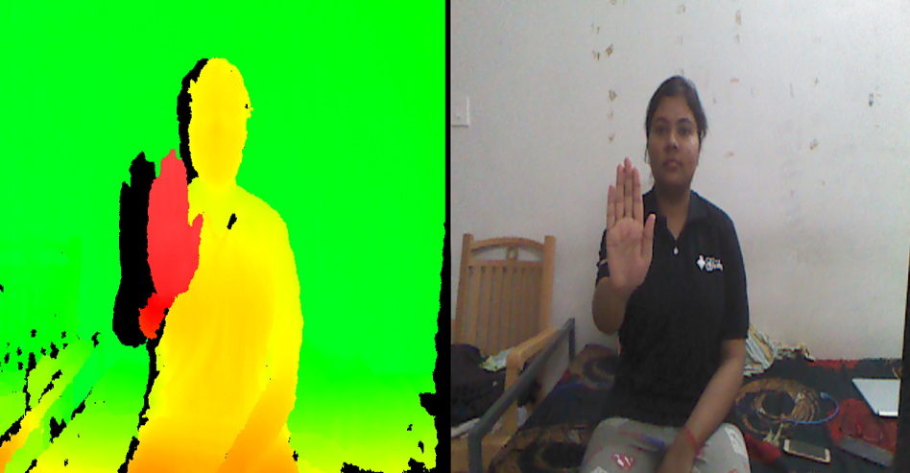
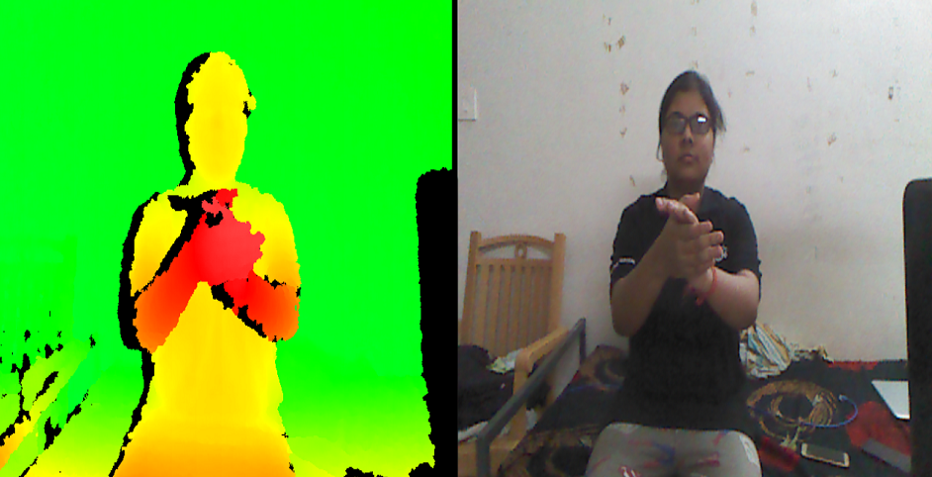
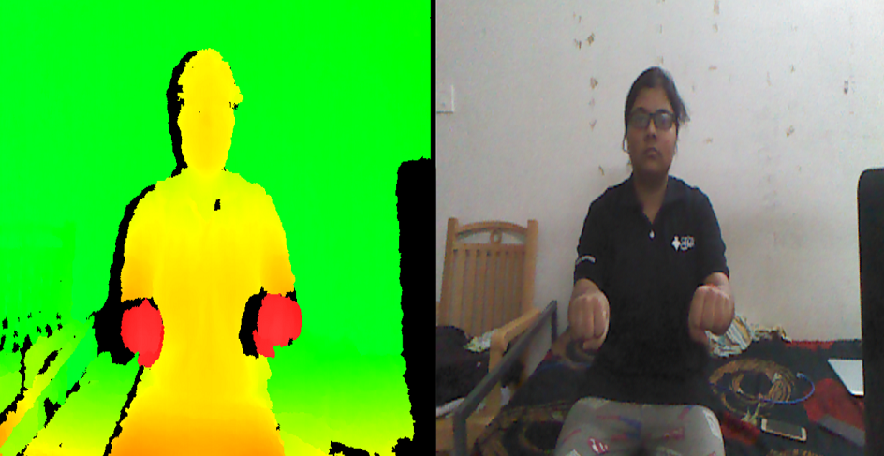
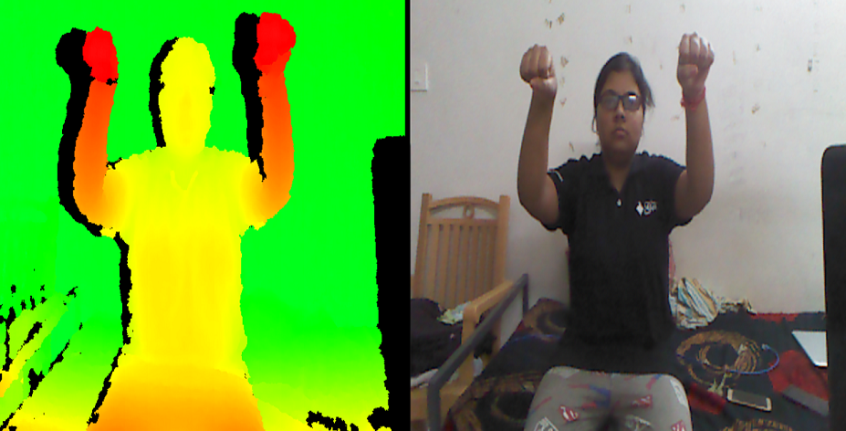
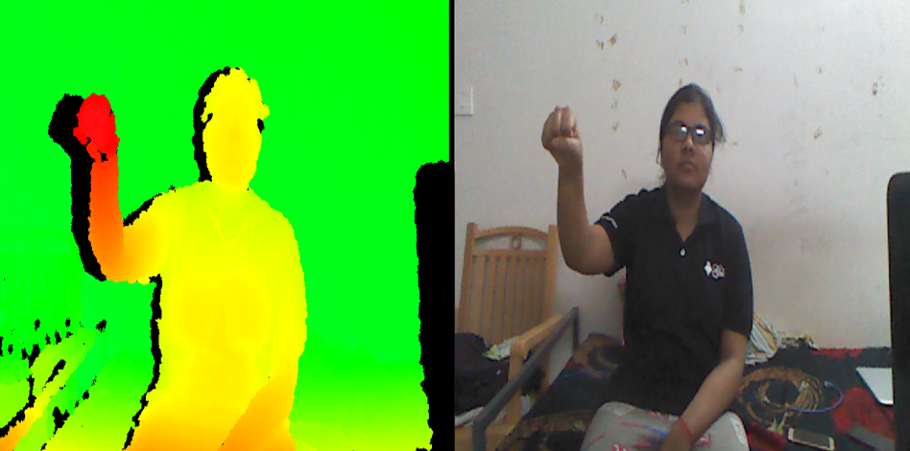
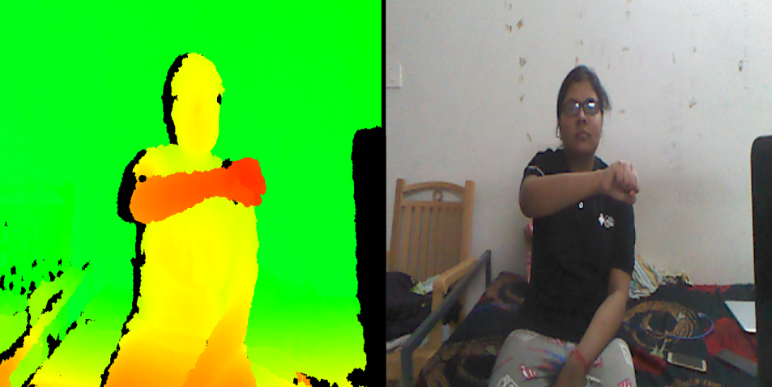
KINECT DEPTH vs RGB IMAGE OF INPUT GESTURES
Palm
Clap
Both Up
Both Down
Rotate Anti-Clockwise
Rotate Clockwise

Slide 12
METHODOLOGY

Slide 13
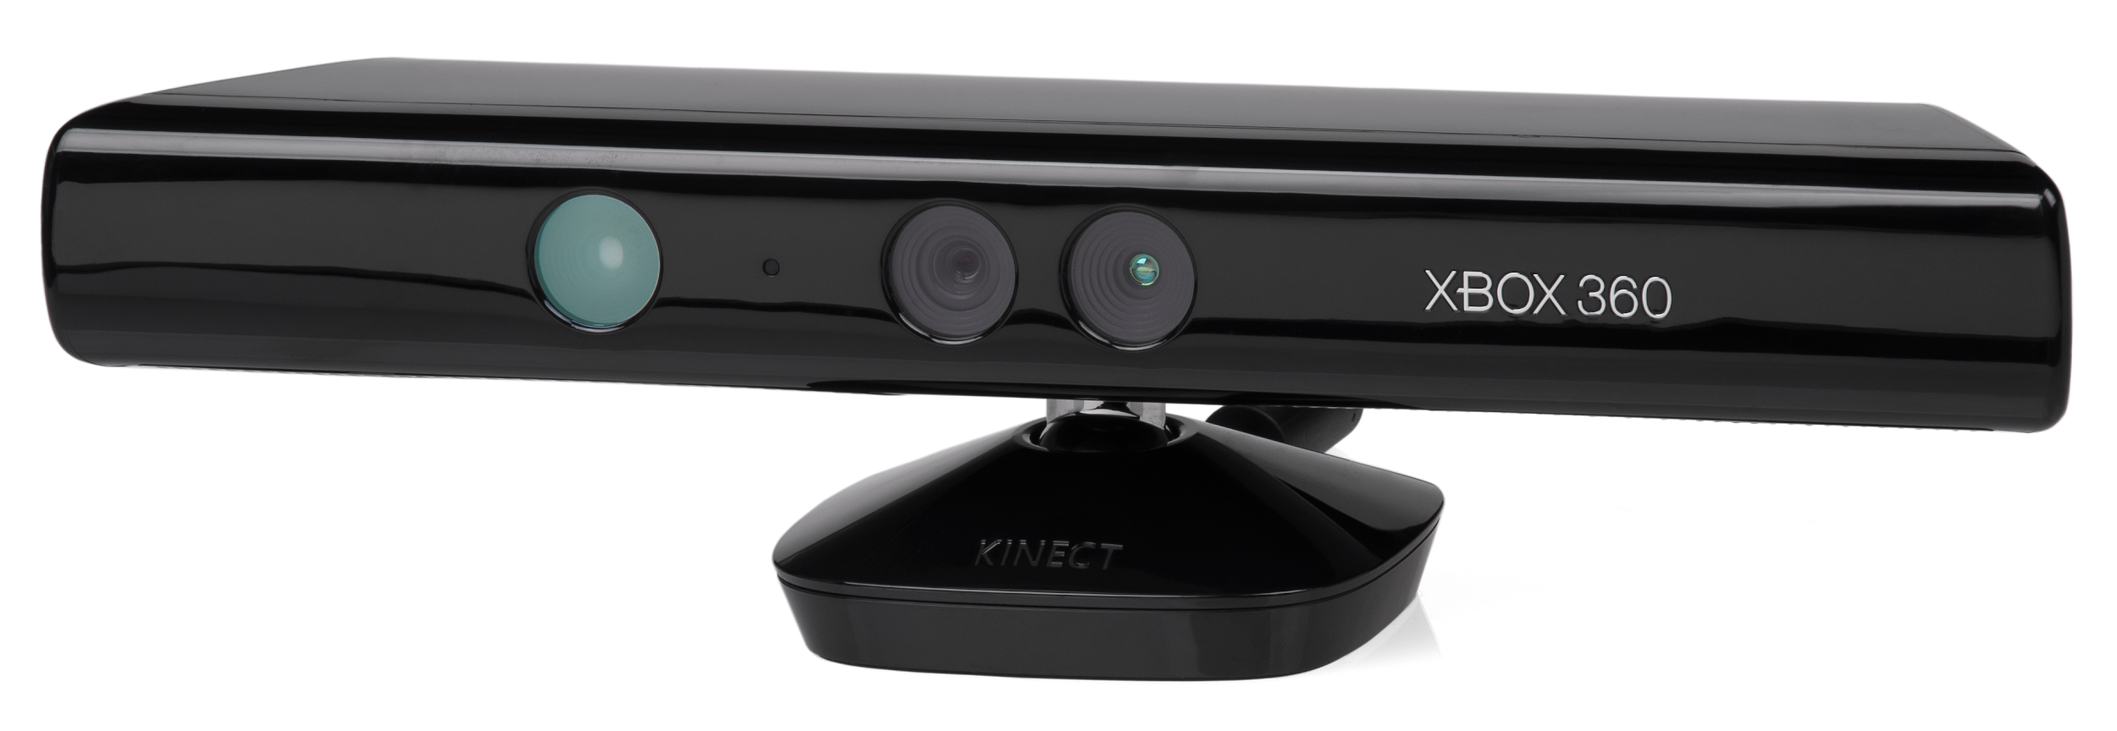
FLOWCHART
FOR
TRAINING
PHASE
Depth information from kinect
Segment hand area using depth thresholding
Extract frames from video
Extract HoG features from each frame and concatenate to form feature vector
Training SVM classifier

Slide 14

Depth information from kinect
Segment hand area using depth thresholding
Extract frames from video
Extract HoG features from each frame and concatenate to form feature vector
SVM classifier for gesture prediction
Generate VLC command corresponding to predicted gesture

Slide 15
INPUT
●The user sits in front of Kinect sensor and performs appropriate gestures.
● The depth map is captured by Kinect. It is assumed that the user will be nearest to the depth camera and facing it.

Slide 16
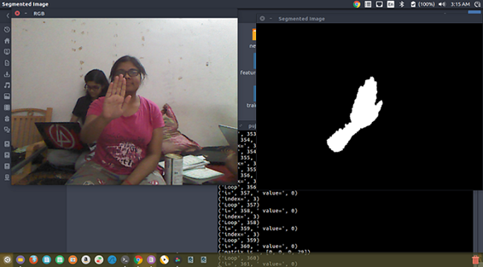
HAND DETECTION AND SEGMENTATION
Hand segmentation was done using depth thresholding.
A binary image was created in which only those pixels were marked as one whose value was less than the specified threshold and rest pixels were kept as zero.
20 such depth thresholded frames were captured for each gesture.
RGB image captured by kinect
Segmented hand with depth thresholding

Slide 17




















Depth Thresholded frames of gesture Clap

Slide 18
FEATURE EXTRACTION
Feature extraction is the process by which certain features of interest within an image are detected and represented for further processing.
It is the transition from pictorial to non-pictorial data representation.
We have used HoG (Histogram of Oriented Gradients) for feature extraction.
This feature descriptor is used for the purpose of object detection.
The HoG are extracted from each of the 20 captured frames and concatenated to form the feature vector.

Slide 19
CLASSIFICATION
To recognize the hand gestures using HOG features, we trained a multi-class SVM classifier which will classify hand gestures into six gestures:
Clapping
Both hands up
Both hands down
Clockwise Rotation
Anti-Clockwise Rotation
Palm

Slide 20
VLC INTERACTION
The testing phase gives us the predicted label for the gesture performed.
The labels for each class are:
> Clapping - ‘C’
>Both hands up - ‘BU’
>Both hands down - ‘BD’
>Anticlockwise rotation - ‘RA’
>Clockwise rotation - ‘RC’
>Palm - ‘P’
After getting the predicted label we use vlc-ctrl commands for generating the corresponding action.

Slide 21
RESULTS

Slide 22
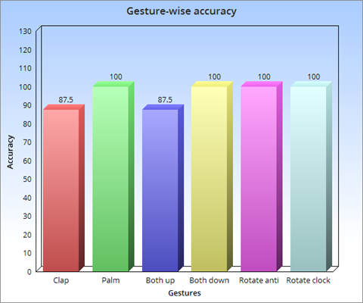
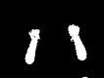
Confusion between ‘Clap’ and ‘Both up’, and ‘Clap’ and ‘Both down’ due to similarity between some of the frames.
Otherwise high accuracy for each gesture.
Fig. Bar chart showing gesture-wise accuracy

Slide 23
 | Clap | Rotate Anti | Rotate Clock | Both Up | Both Down | Palm
Clap | 87.5 | 0 | 0 | 0 | 12.5 | 0
Rotate Anti | 0 | 100 | 0 | 0 | 0 | 0
Rotate Clock | 0 | 0 | 100 | 0 | 0 | 0
Both Up | 12.5 | 0 | 0 | 87.5 | 0 | 0
Both Down | 0 | 0 | 0 | 0 | 100 | 0
Palm | 0 | 0 | 0 | 0 | 0 | 100
Fig. Confusion matrix of gesture recognition accuracy

Slide 24
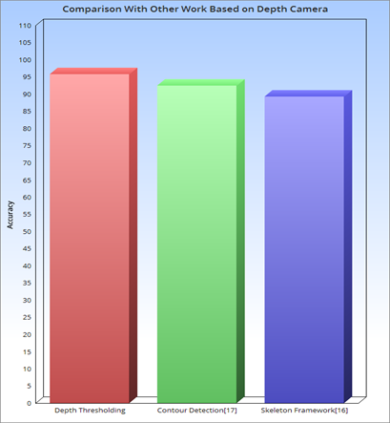
[4] uses skeleton tracking and gestures were recognized using HMM. Tested on ISL 20 dynamic signs. Achieved 89.25% average accuracy.
[5] uses contour tracking and dynamic time warping to recognize gestures. Achieved an average recognition rate of 92.4% was over 55 static and dynamic gestures.
Our methodology, which uses depth thresholding and SVM for gesture recognition, achieved an average accuracy of 95.83%.
Fig. Bar chart showing accuracy comparison with other depth camera based work

Slide 25
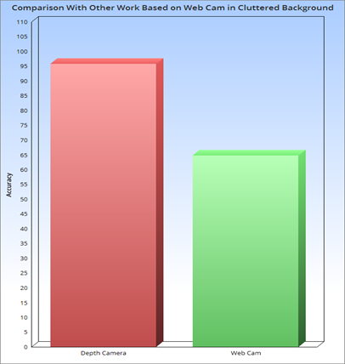
Proposed methodology gives better gesture recognition rate than when only RGB information is used.
[6] achieved average accuracy of 92.28% in plain background. Accuracy dropped to 64.85% in case of cluttered background.
The objects in the background prove to be inconsistencies to the image capture process when only RGB information is used, resulting in faulty outputs.
Our methodology overcomes this drawback by using the depth information provided by kinect.
Fig. Bar chart showing accuracy comparison with webcam based work

Slide 26
SOFTWARE & HARDWARE REQUIREMENTS
● Implementation Language: Python 2.7
● Libraries: NumPy, OpenCV3, Scikit-learn, Freenect, Scipy, SimpleCV.
● Operating System Used: Ubuntu 16.04LTS.
● Hardware Requirements: 64-bit environment, Intel Core i5 CPU @ 2.60 GHz with 8GB of RAM, Kinect camera(XBOX-360-version-1).

Slide 27
CONCLUSION
● We have presented an application by which the user can control the functions of VLC media player from a distance without using mouse and keyboard.
● The major motivation behind the work was to decrease the use of a physical devices for man-machine interaction.
● The software works properly in different environments, like in variant lighting conditions(dark), invariant to clutter in background, doesn't depend on skin color and size of hands.
● Our system takes input in the form of dynamic hand gesture performed by the user which is the command corresponding to a particular function of VLC media player.

Slide 28
FUTURE SCOPE
● The main hardware requirement Kinect(XBOX-360-Version-1)Camera is an expensive equipment, not available to the common people.
● At present our application works for VLC media player but in the future it can be generalized to work for any media player.
● Furthermore the accuracy obtained by the implemented method can be improved and the system can be made more robust to variations in hand gestures, performing styles and speed.
● The work has the potential to be applied in other HCI applications that adopt hand gestures as the interface.

Slide 29
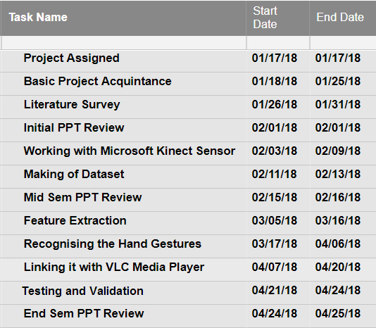
ACTIVITY TIME CHART

Slide 30
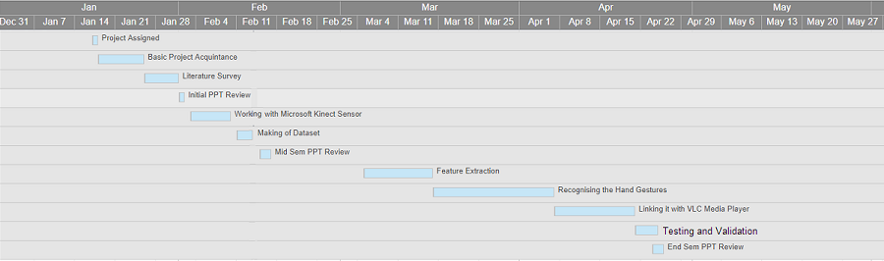
GANTT CHART

Slide 31
DEMONSTRATION

Slide 32
REFERENCES
[1] R.Aggarwal, S. Swetha, A. M. Namboodiri, J. Sivaswamy and C. V. Jawahar,”Online handwriting recognition using depth sensors,” 2015 13th International Conference on Document Analysis and Recognition (ICDAR), Tunis, 2015, pp. 1061-1065.
[2] Y. Chen, B. Luo, Y. L. Chen, G. Liang and X. Wu, “A real-time dynamic hand gesture recognition system using kinect sensor,” 2015 IEEE International Conference on Robotics and Biomimetics (ROBIO), Zhuhai, 2015, pp. 2026-2030.
[3] Yi Li,”Hand gesture recognition using Kinect,”; 2012 IEEE International Conference on Computer Science and Automation Engineering, Beijing, 2012, pp. 196-199.
[4] Ghotkar, Archana & Vidap, Pujashree & Deo, Kshitish. (2016). Dynamic Hand Gesture Recognition using Hidden Markov Model by Microsoft Kinect Sensor. International Journal of Computer Applications. 150. 5-9. 10.5120/ijca2016911498.
[5] G. Plouffe and A. M. Cretu, "Static and Dynamic Hand Gesture Recognition in Depth Data Using Dynamic Time Warping," in IEEE Transactions on Instrumentation and Measurement, vol. 65, no. 2, pp. 305-316, Feb. 2016
[6] Aashni Haria, Archanasri Subramanian, Nivedhitha Asokkumar, Shristi Poddar, Jyothi S Nayak, "Hand Gesture Recognition for Human Computer Interaction", Procedia Computer Science, Volume 115,2017, Pages 367-374,ISSN 1877-0509.

Slide 33
THANK YOU

